Slide 1
The Architectural components of the Smarter Traffic System

Slide 2
The Architectural components of the Smarter Traffic System
As far as physical components are concerned, a smarter traffic system has to include traffic lights, sensors, and actuators within its jurisdictional region so that the reaction time is on the order of <10 milliseconds.
A miniaturized orchestration platform is an overseeing software solution, which has to be a part and parcel of the system.
This module is greatly obligated to orchestrate and manage all the other software modules of the system effectively.
It has to be policy-aware.
That is, well-intended policies can be established easily and enforced accordingly toward effective governance.

Slide 3
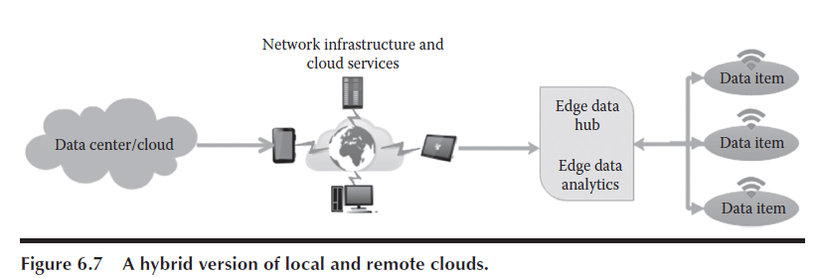

Slide 4
The Architectural components of the Smarter Traffic System
A centralized decision-enabling module is another noteworthy one for garnering data from all the deployed traffic lights and pushing the decisions to individual traffic lights through a messaging bus, which is another mandatory software solution for enabling data transmission on both directions.
There can be multiple smarter traffic systems from different providers tied up with different networking and communication service providers.
All these deviations and deficiencies need to be addressed systematically in order to accomplish edge analytics.
Thus, any edge analytics software solution has to take multiple scenarios and factors into consideration in order to be right and relevant for realizing real-time applications such as smarter traffic.

Slide 5
The Architectural components of the Smarter Traffic System
Systems are capable of taking lightning-fast yet correct decisions, which are turning out to be essential for the projected smarter world.

